Slide 1
Coursera Capstone project
Coursera IBM Data Science Certification
Vishnu Prasad Mp
Auguest 5th 2020

Slide 2
Report Content
1. Introduction Section :
⁃ The “business problem” to be solved by this project and who may be interested
2. Data Section:
⁃ Describe Data requirements and Sources needed to solve the problem
3. Methodology section:
⁃ Main component of the report Execute data processin,describe/discuss any exploratory data analysis and/or inferential statistical testing performed, and/or machine learnings used.
4. Results section:
⁃ Discussion of the results and finding of answer
5. Discussion section:
⁃ Discussion of observations noted and any recommendations
6. Conclusion section:
⁃ Answer chosen and conclusions.

Slide 3
1. Introduction
1.1 Scenario and Background
I am currently living in Singapore, within walking distance to Downtown "Telok Ayer
MRT metro station" . I also enjoy great venues and attractions, such as international
cuisine, entertainment and shopping. I have an offer to move to work to Manhattan NY
and I would like to move if I can find a place to live similar with similar venues.
1.2 Problem to be resolved:
How to find an apartment in Manhattan with the following conditions:
• Apartment with min 2 bedrooms
• Monthly rent not to exceed US$7000/month
• Located within walking distance (<=1.0 mile, 1.6 km) from a subway metro station in Manhattan
• Venues and amenities as in my current residence.
1.3 Interested Audience
I believe the methodology, tools and strategy used in this project is relevant for a person or entity considering moving to a major city in US, Europe or Asia. Europe, US or Asia, Likewise, it can be helpful approach to explore the opening of a new business. The use of FourSquare data and mapping techniques combined with data analysis will help
resolve the key questions arisen. Lastly, this project is a good practical case for a person
developing Data Science skills.

Slide 4
2. Data Section
2.1 Data Requirements
- Geodata for current residence in Singapore with venues established using Foursquare.
- List of Manhattan (MH) neighborhoods with clustered venues established via Foursquare (as in Course
Lab). https://en.wikipedia.org/wiki/List_of_Manhattan_neighborhoods#Midtown_neighborhoods
- List of subway metro stations in Manhattan with addresses and geo data (lat,long): https://
en.wikipedia.org/wiki/List_of_New_York_City_Subway_stations_in_Manhattan) , https://www.google.com/maps/search/manhattan+subway+metro+stations@40.7837297,74.1033043 , 11z/data=!3m1!4b1)
- List of apartments for rent in Manhattan area with information on neighborhood location, address, number of beds, area size, monthly rent price and complemented with geo data via Nominatim. http://www.rentmanhattan.com/index.cfm?page=search&state=results https://www.nestpick.com/search?city=new-
- Place to work in Manhattan (Park Avenue and 53rd St) for reference
2.2 Data Sources, Data Processing and Tools used
- Singapore data and map is to be created with use of Nominatim , Foursquare and Folium mapping
- Manhattan neighborhoods were obtained from Wikipedia and organized by Neighborhoods with geodata via Nominatim for mapping with Folium.
- List of Subway stations was obtained via Wikipedia, NY Transit web site and Google map,
- List of apartments for rent was consolidated from web-scraping real estate sites for MH. The geolocation (lat,long) data was found with algorithm coding and using Nominatim.
- Folium map was the basis of mapping with various features to consolidate all data in ONE map where one can visualize all details needed to make a selection of apartmen

Slide 5
3. Methodology
The Strategy to find the answer:
The strategy is based on mapping the described data in section 2.0, in order to
facilitate the choice of at least two candidate places for rent. The information will be
consolidated in ONE MAP where one can see the details of the apartment, the cluster
of venues in the neighborhood and the relative location from a subway station and
from work place. A measurement tool icon will also be provided. The popups on the
map items will display rent price, location and cluster of venues applicable.
The Tools:
Web-scraping of sites is used to consolidate data-frame information which was
saved as csv files for convenience and to simply the report. Geodata was obtained
by coding a program to use Nominatim to get latitude and longitude of subway
stations and also for each of (144 units) the apartments for rent listed.
Geopy_distance and Nominatim were used to establish relative distances. Seaborn
graphic was used for general statistics on rental data.
Maps with popups labels allow quick identification of location, price and feature, thus
making the selection very easy

Slide 6
4. Execution and Results

Slide 7
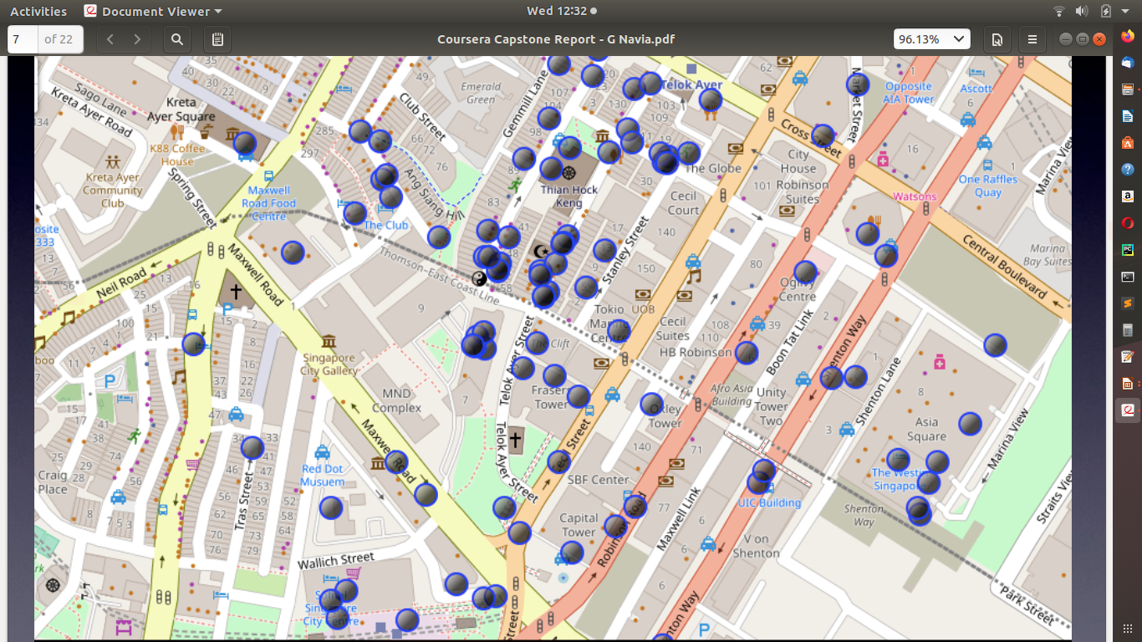
Current residence Neighborhood in Singapore

Slide 8
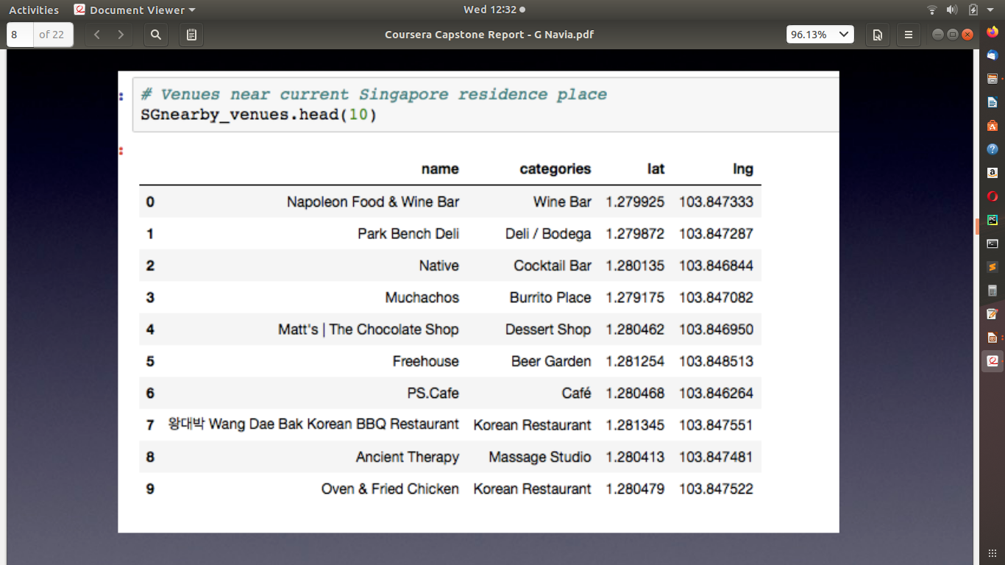
Venues around Neighborhood in

Slide 9
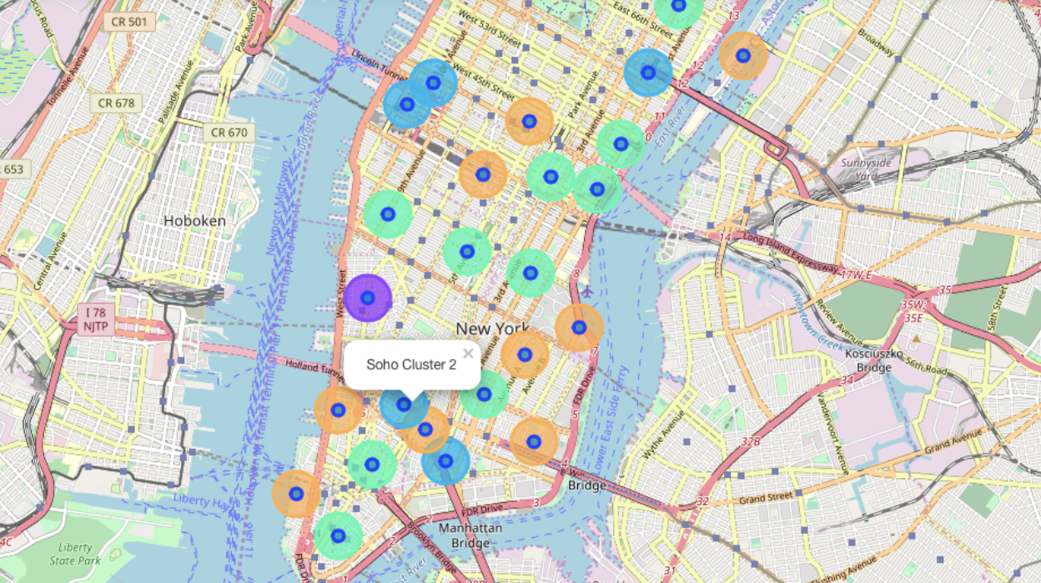
Manhattan Map - Neighborhoods and Cluster of Venues

Slide 10
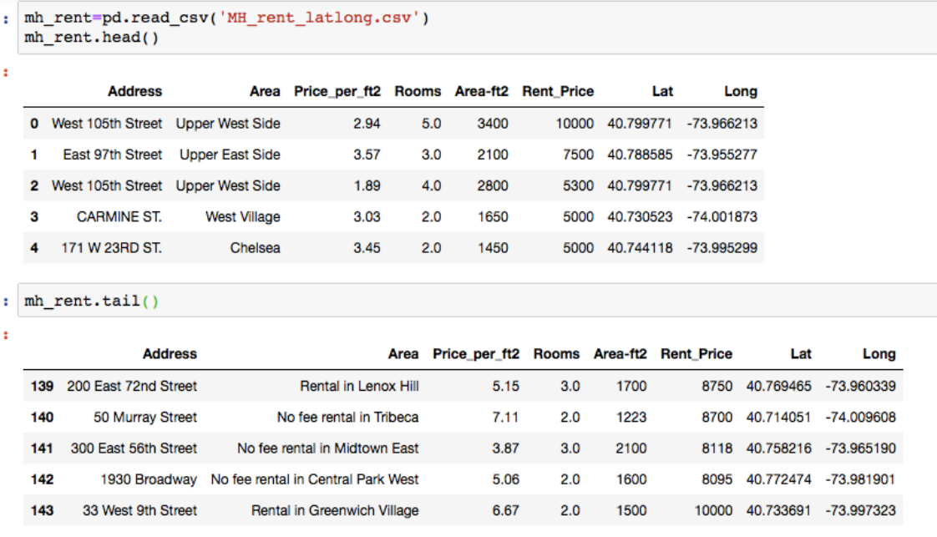
GeoData Manhattan apts for rent

Slide 11
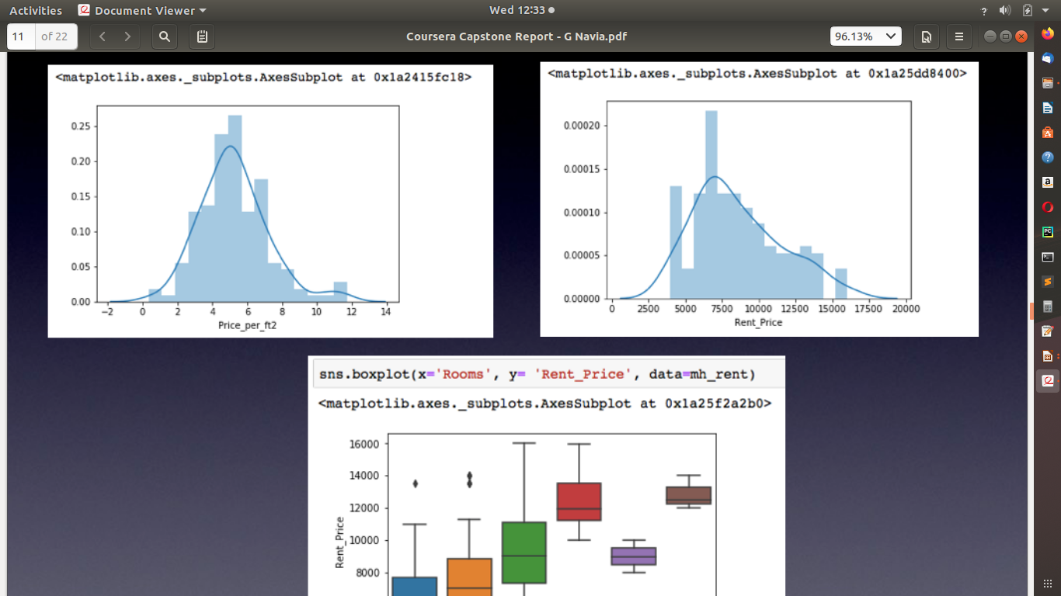
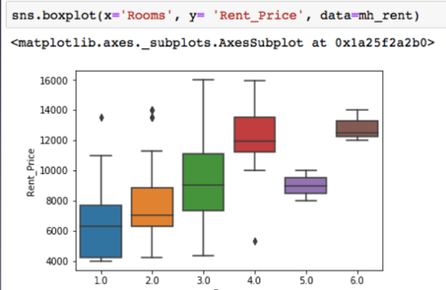
Rental Price Statistics MH Apartments
Budget US7000/month is around the mean

Slide 12
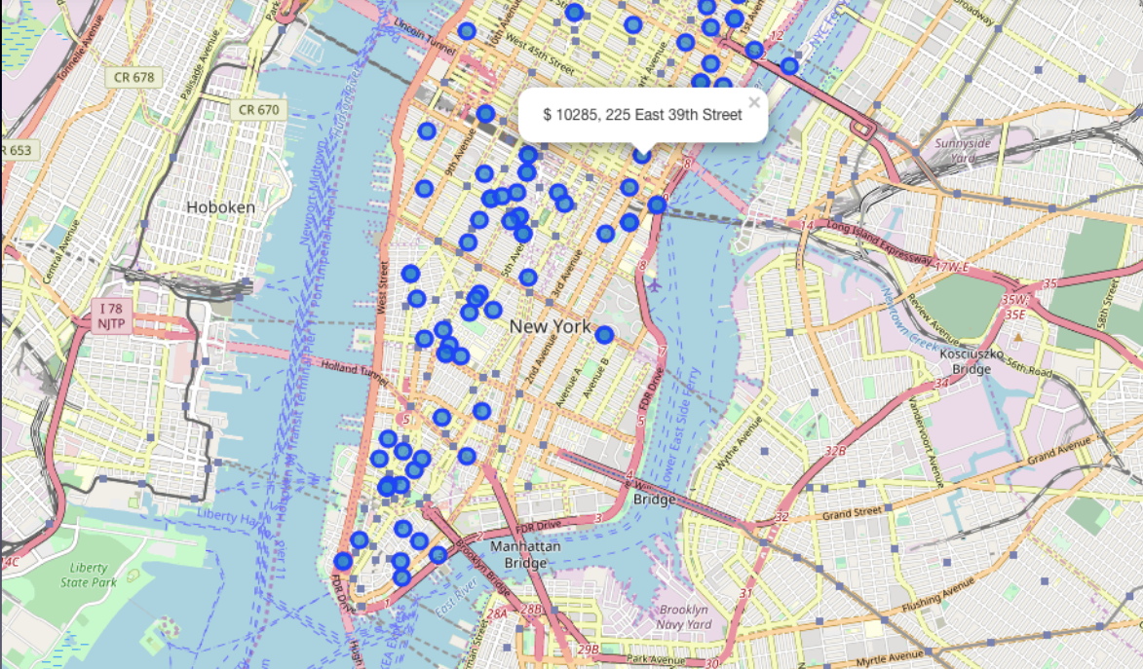
Apartments for Rent in MH

Slide 13
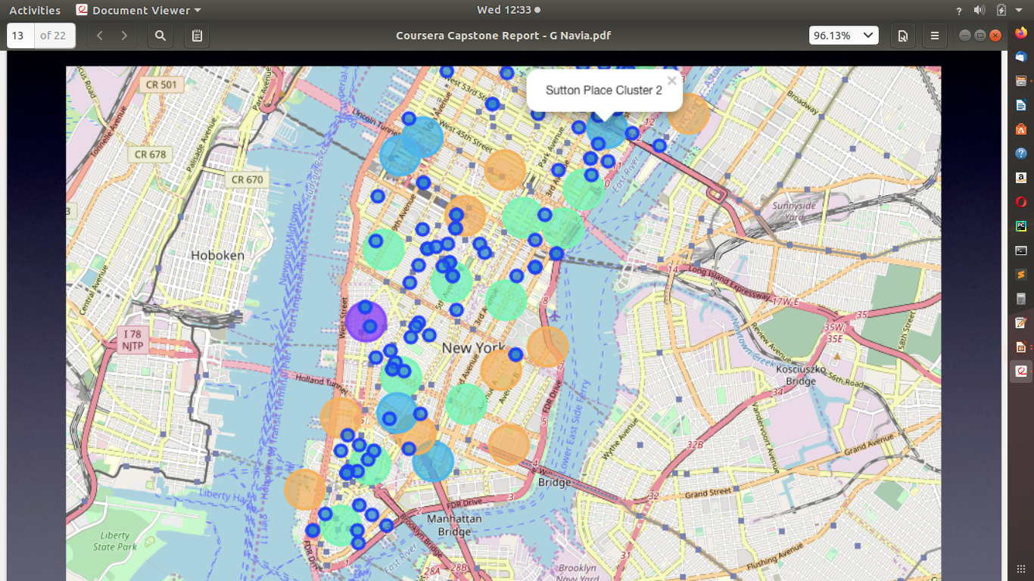
MH apts for rent with venue clusters

Slide 14
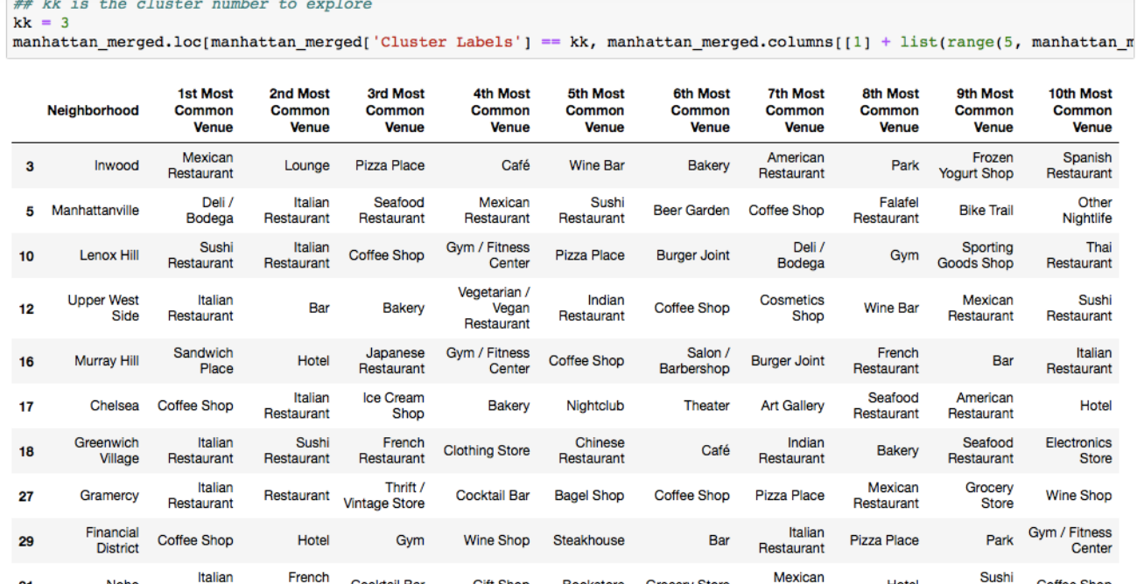
Venues of cluster 3

Slide 15
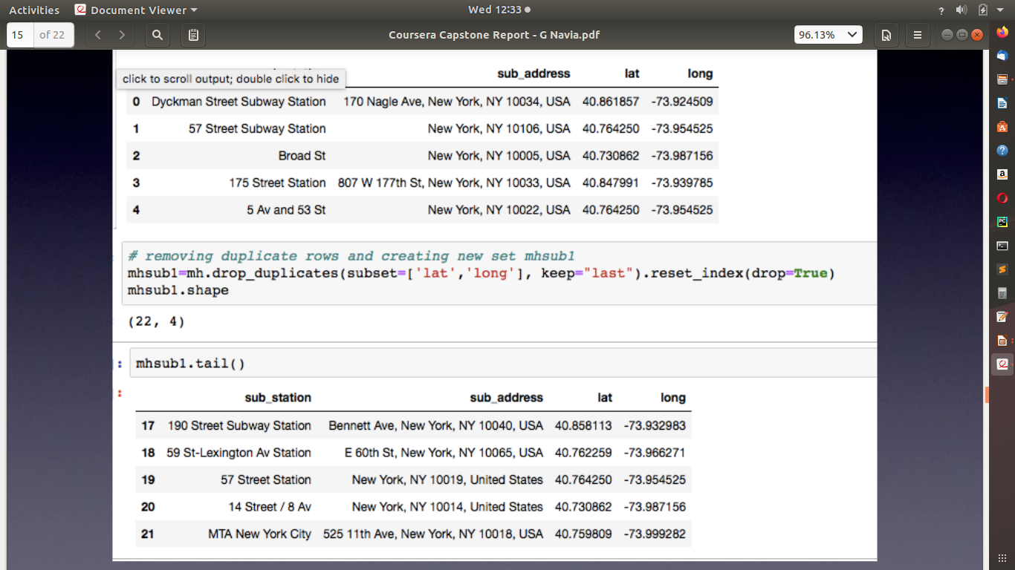
Manhattan subway stations geodata

Slide 16
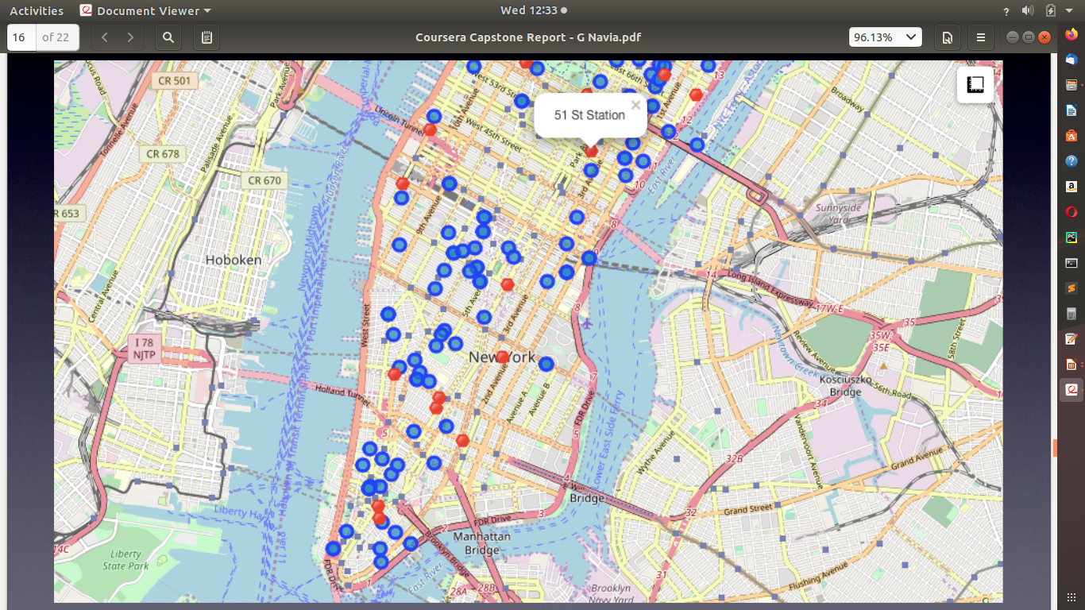
Apts for rent (blue) and subway stations (red)

Slide 17
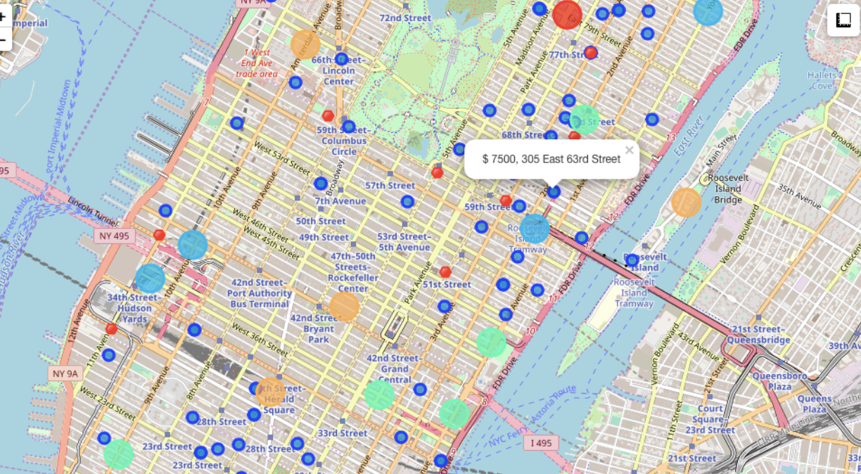
Selected Apartment!
The ONE consolidated map shows all information for decision:
Apartments address, price, neighborhood, cluster of venues and subway station nearby.
Blue dots=apts , Red dots=Subway station, Bubbles=Cluster of Venues

Slide 18
Apartment Selection
Using the "one map" above, I was able to explore all possibilities since the popups
provide the information needed for a good decision.
Apartment 1 rent cost is US7500 slightly above the US7000 budget. Apt 1 is located
400 meters from subway station at 59th Street and work place ( Park Ave and 53rd) is
another 600 meters way. I can walk to work place and use subway for other places
around. Venues for this apt are as of Cluster 2 and it is located in a fine district in the
East side of Manhattan.
Apartment 2 rent cost is US6935, just under the US7000 budget. Apt 2 is located 60
meters from subway station at Fulton Street, but I will have to ride the subway daily
to work , possibly 40-60 min ride. Venues for this apt are as of Cluster 3.¶
Based on current Singapore venues, I feel that Cluster 2 type of venues is a closer
resemblance to my current place. That means that APARTMENT 1 is a better choice
since the extra monthly rent is worth the conveniences it provides.

Slide 19
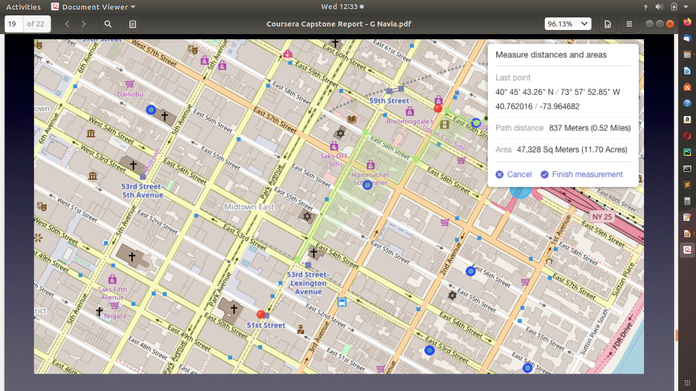
I will walk to work
Walk from home to work is less than 1 km!

Slide 20
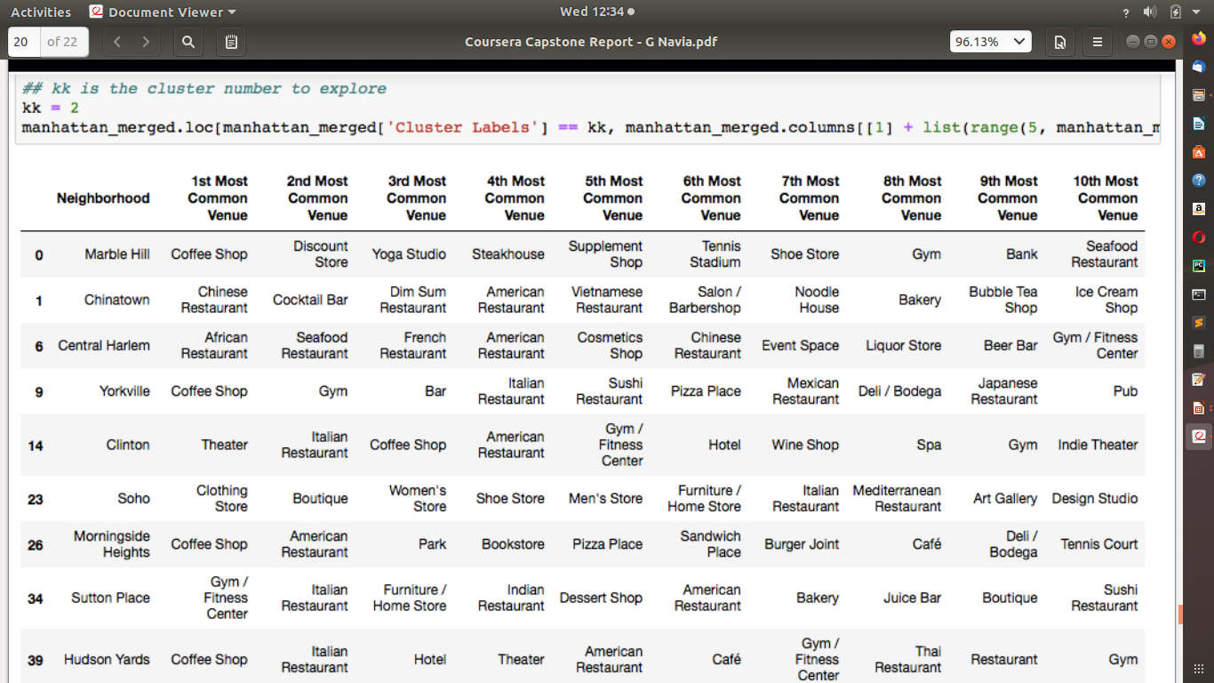
Venus in Cluster 2 near future home

Slide 21
5. Discussion
• In general, I am positively impressed with the overall organization, content and lab works presented during the Coursera IBM Certification Course
• I feel this Capstone project presented me a great opportunity to practice and apply the Data Science tools and methodologies learned.
• I have created a good project that I can present as an example to show my potential.
• I feel I have acquired a good starting point to become a professional Data Scientist and I will continue exploring to creating examples of practical cases.

Slide 22
6. Conclusions
• I feel rewarded with the efforts, time and money spent. I believe this course with all the topics covered is well worthy of appreciation.
• This project has shown me a practical application to resolve a real situation that has impacting personal and financial impact using Data Science tools.
• The mapping with Folium is a very powerful technique to consolidate information and make the analysis and decision thoroughly and with confidence. I would recommend for use in similar situations.
• One must keep abreast of new tools for DS that continue

